Slide 1
Deep Learning (CS 898-BD)
Fall 2023
Dr. Shruti Kshirsagar

Slide 2
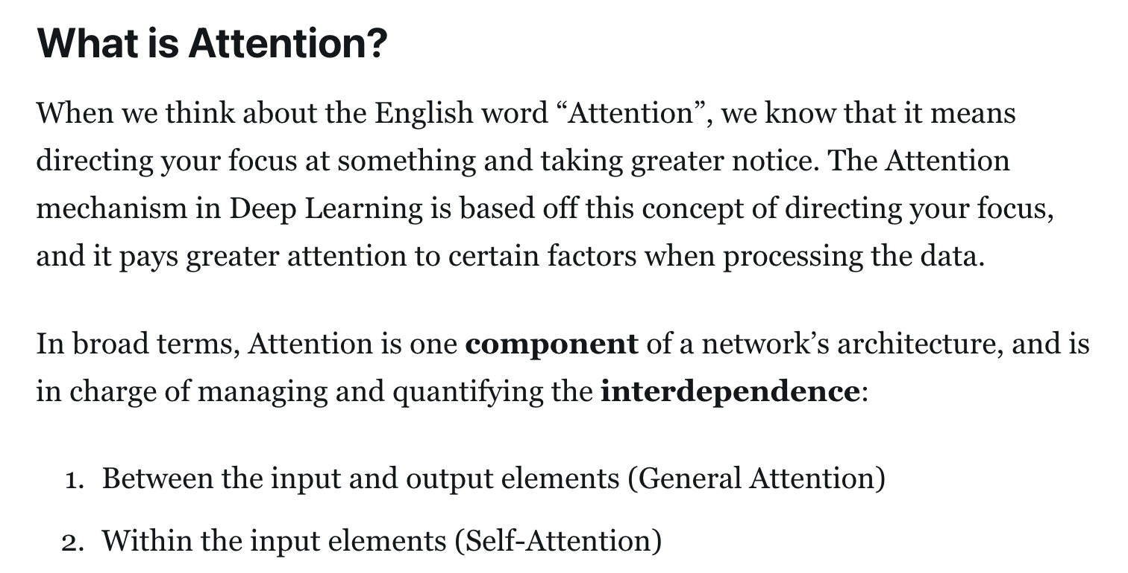
Attention

Slide 3
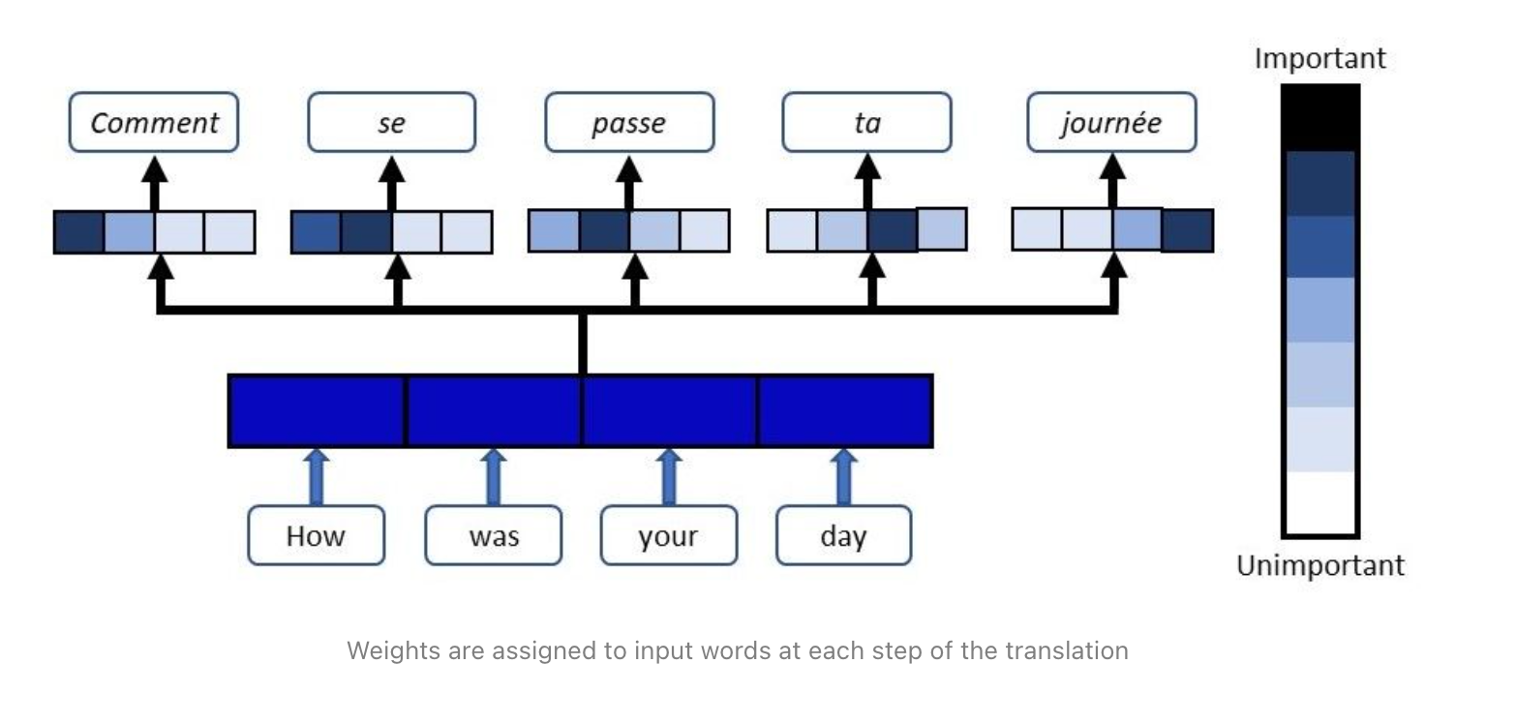
Attention

Slide 4
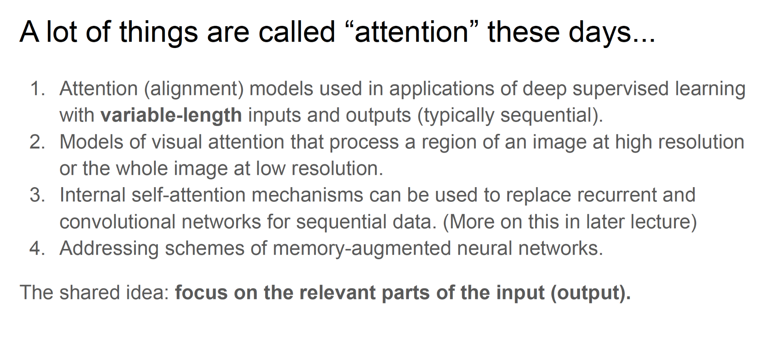
Attention

Slide 5
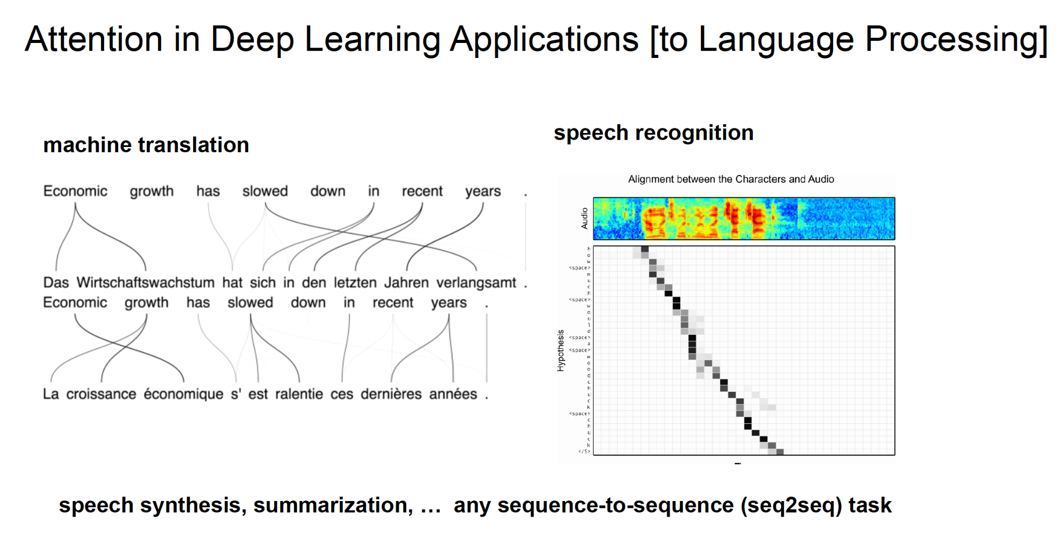
Attention

Slide 6
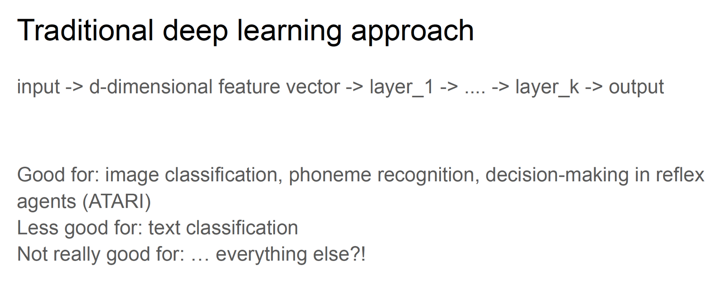
Attention

Slide 7
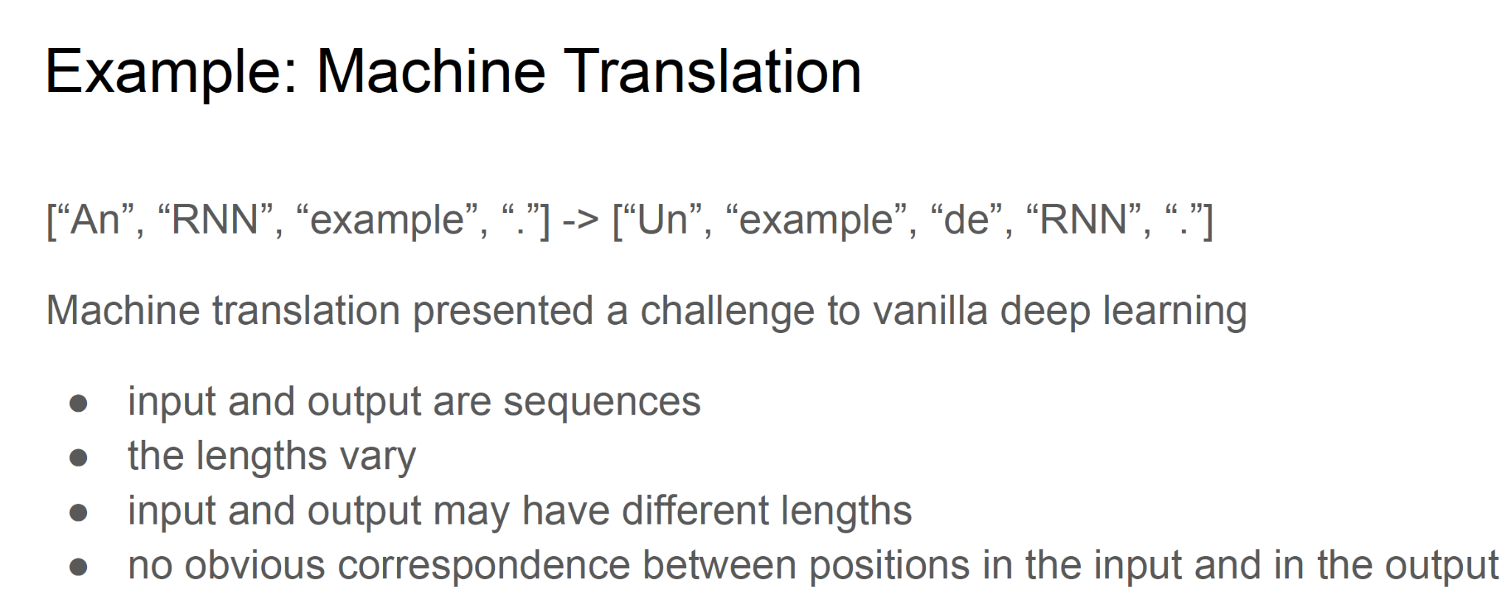
Attention

Slide 8
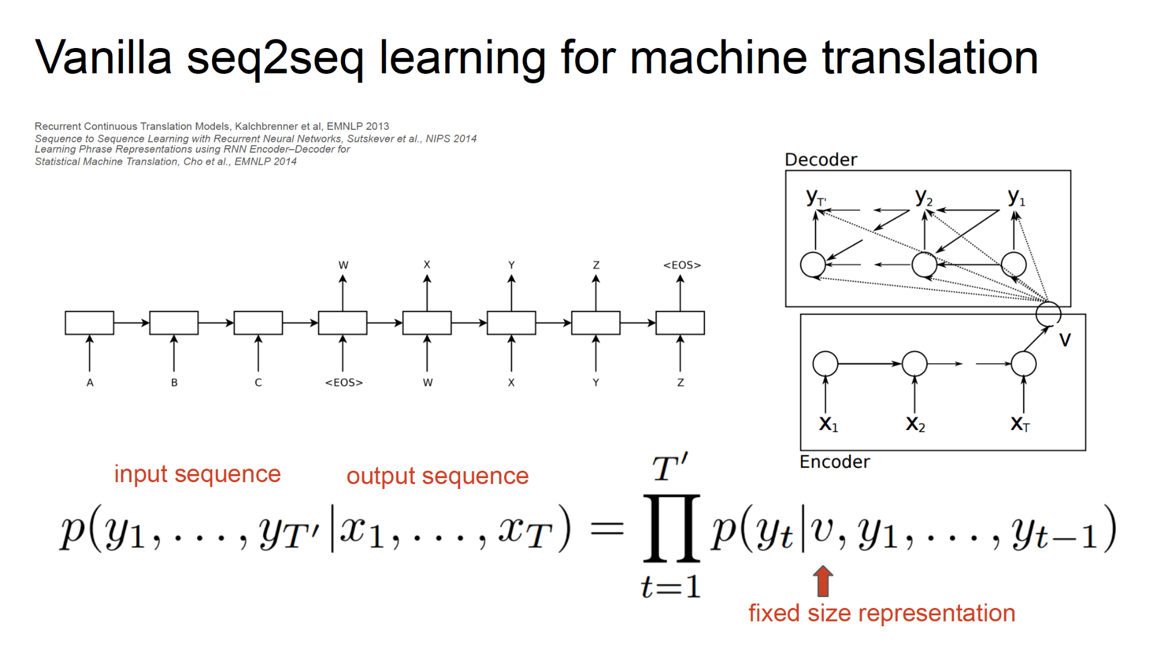
Attention

Slide 9
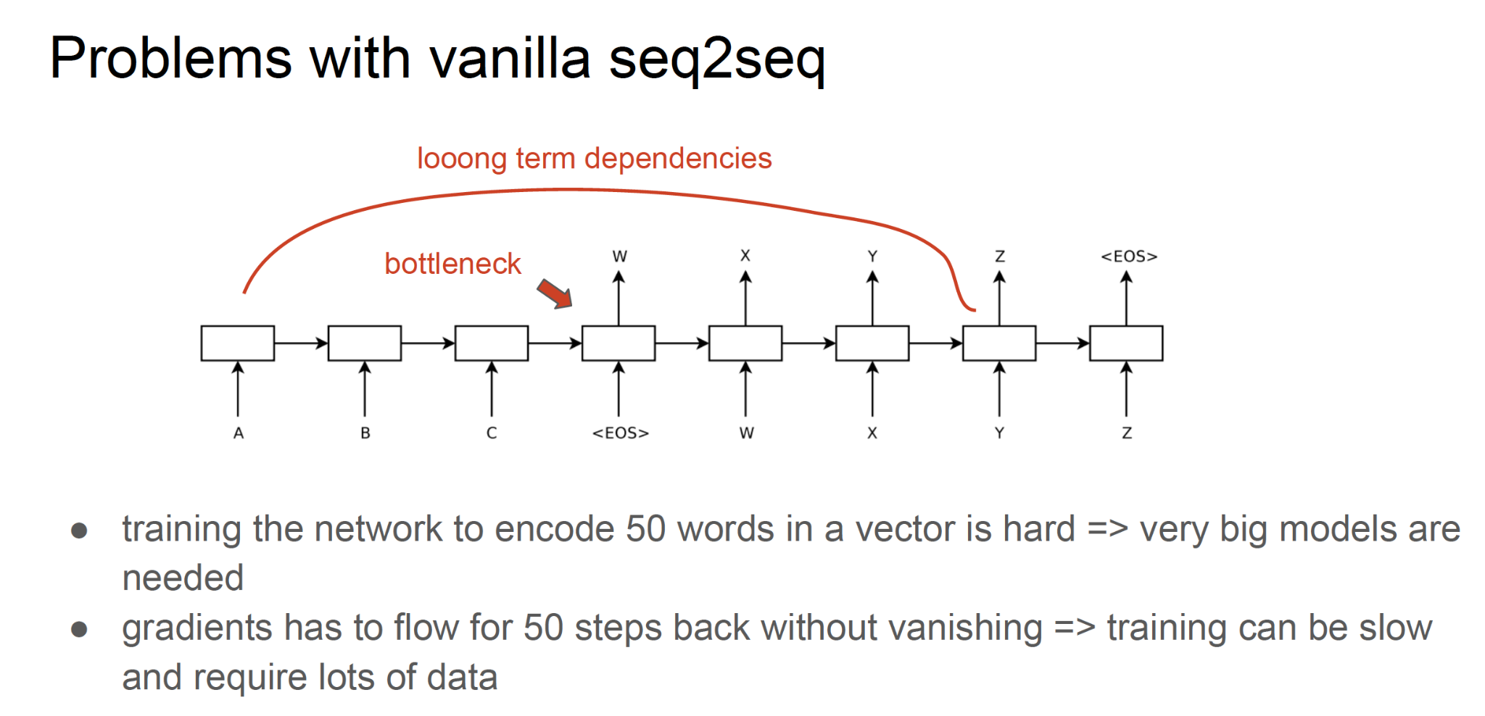
Attention

Slide 10
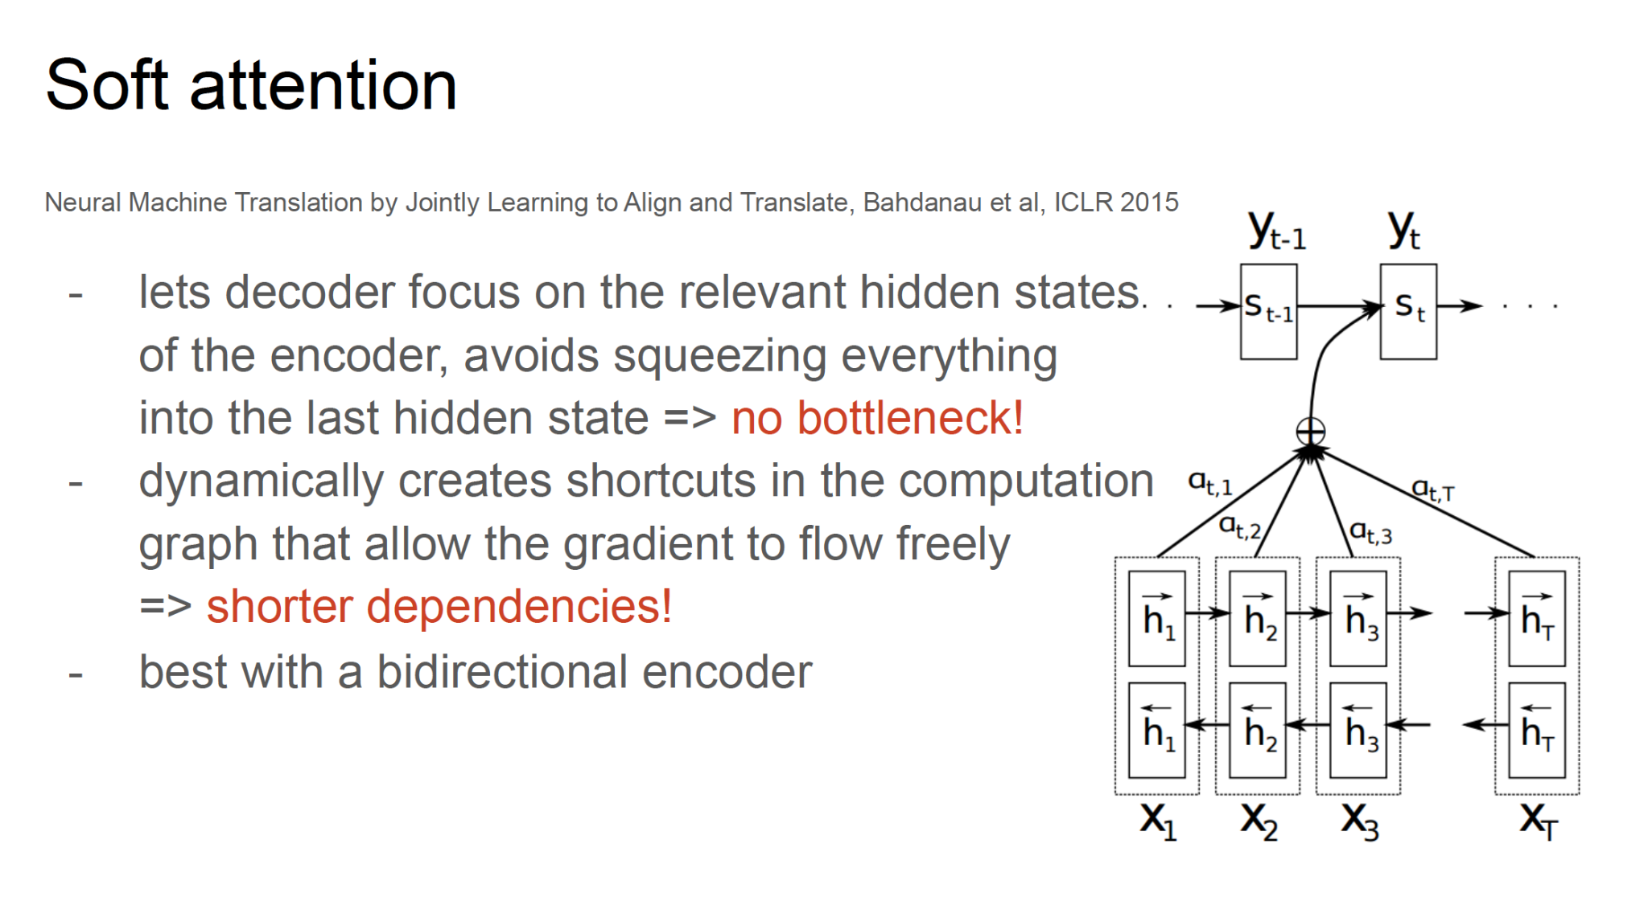
Attention

Slide 11
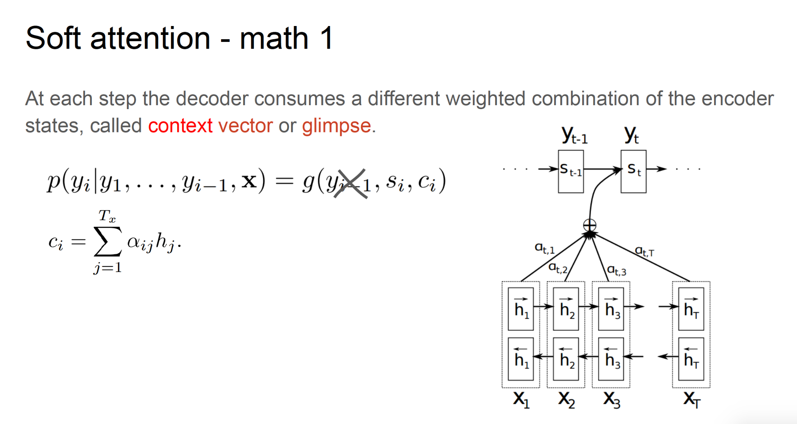
Attention

Slide 12
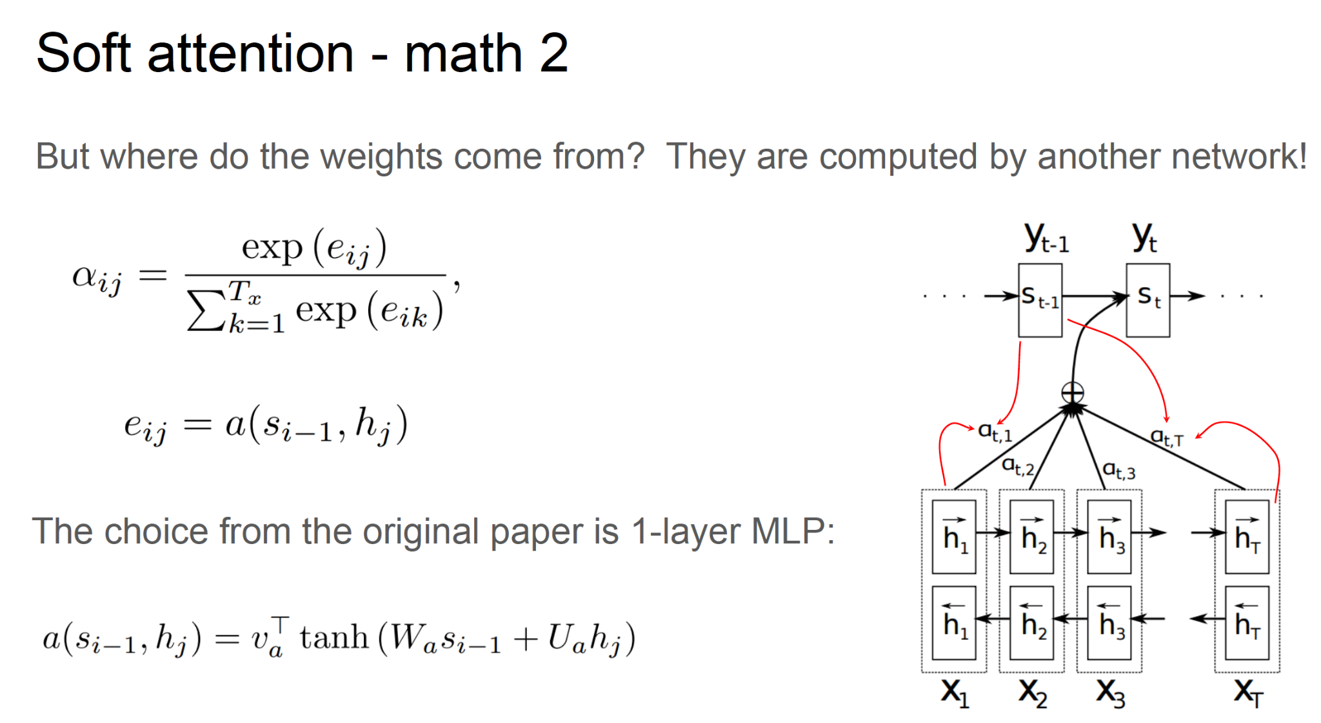
Attention

Slide 13
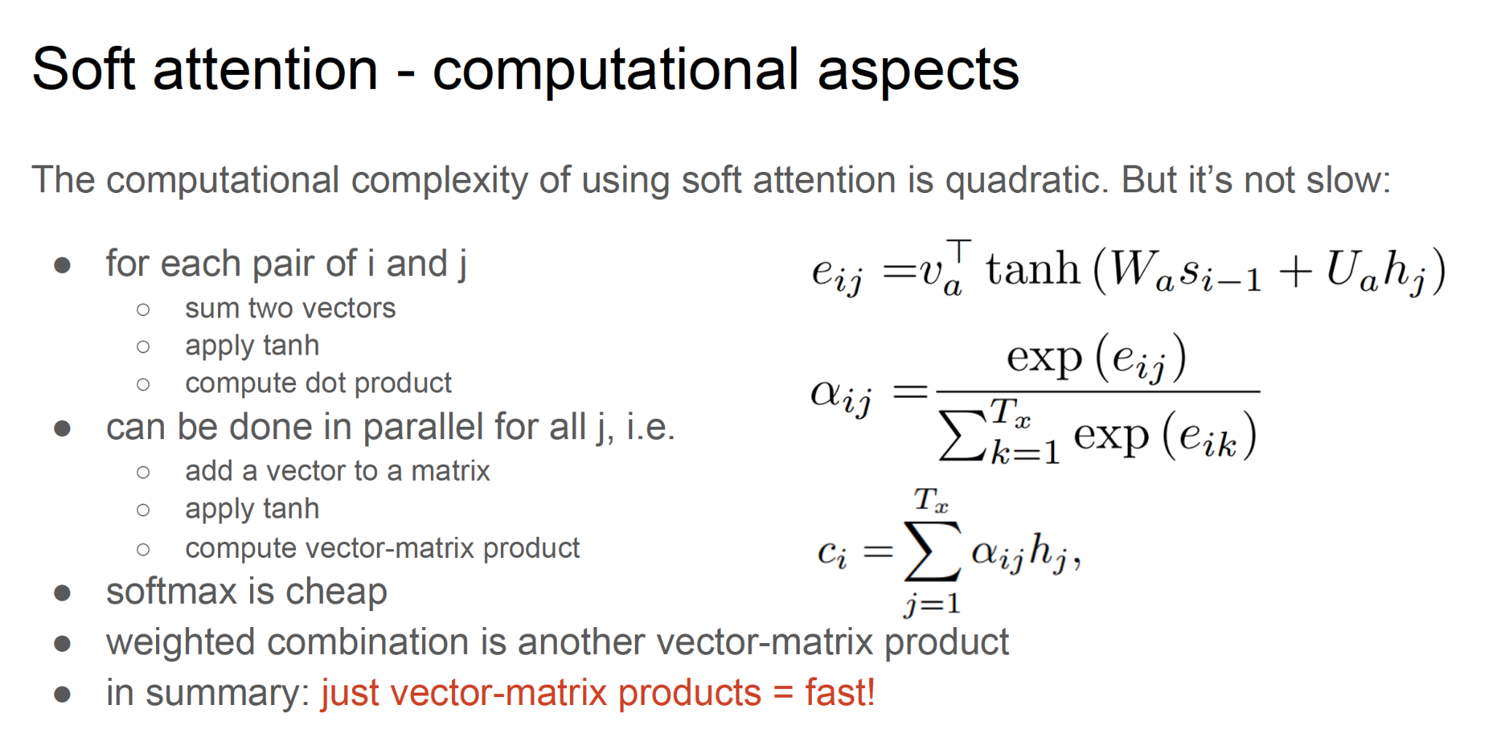
Attention

Slide 14
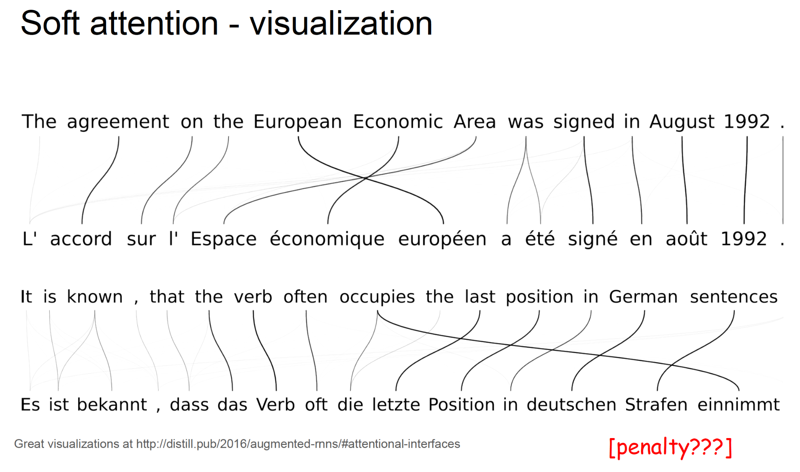
Attention

Slide 15
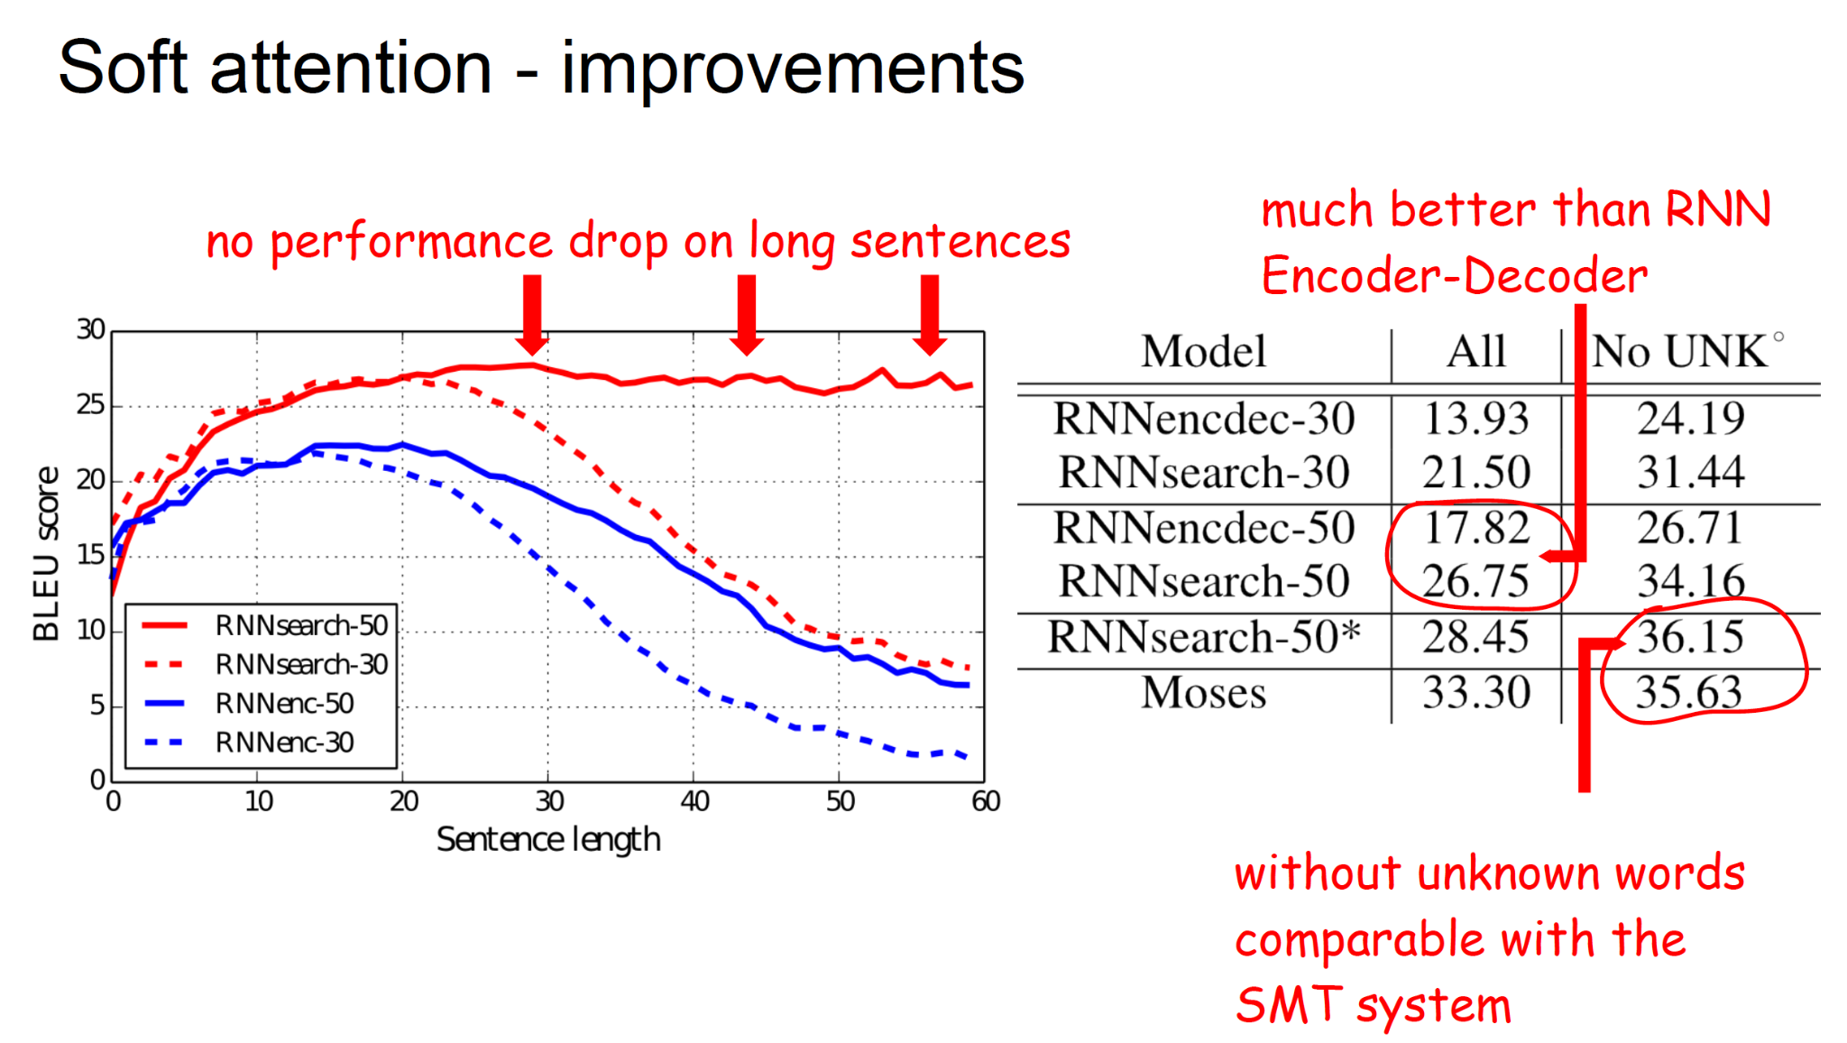
Attention

Slide 16
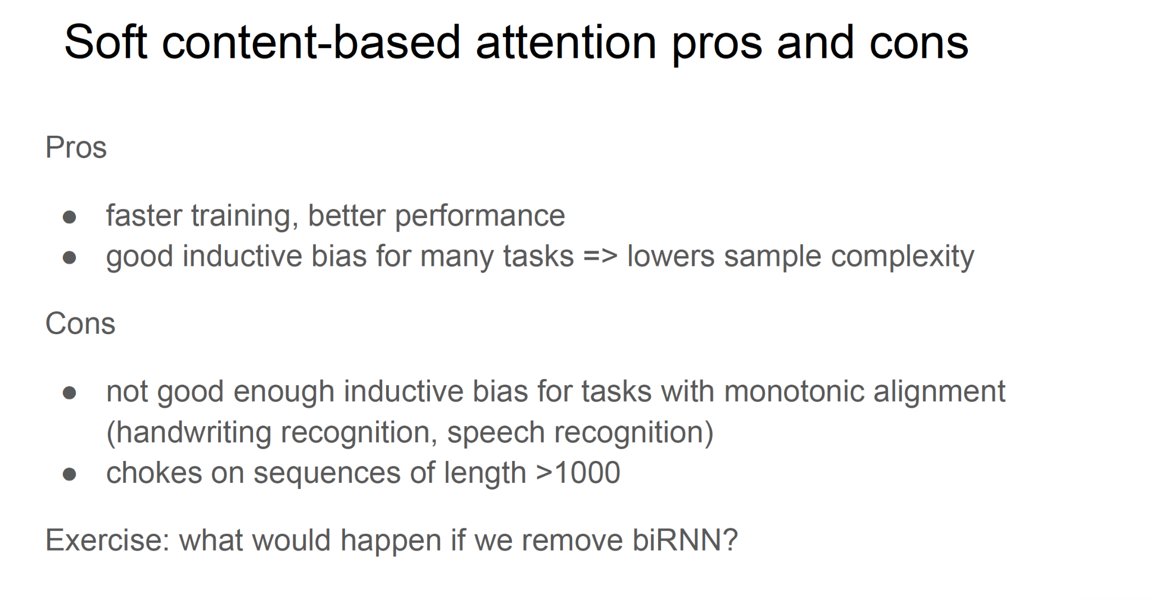
Attention

Slide 17
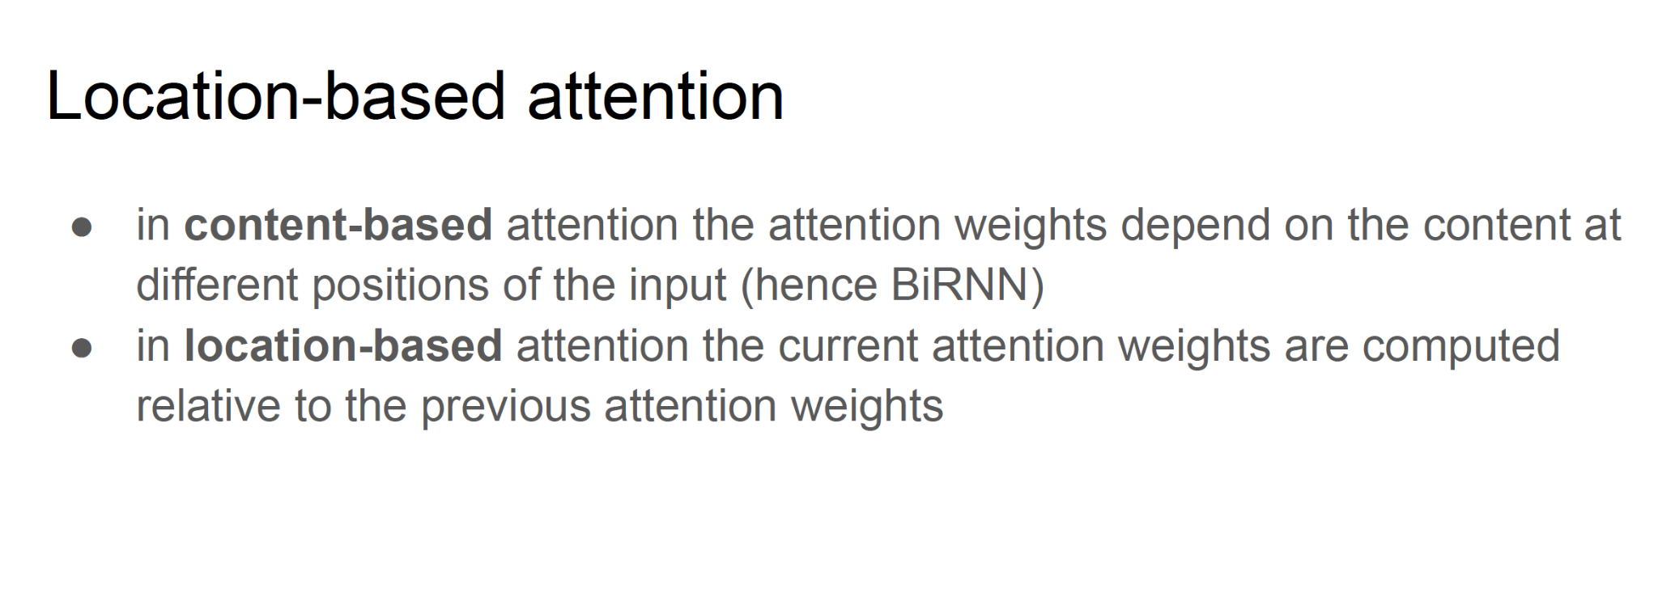
Attention

Slide 18
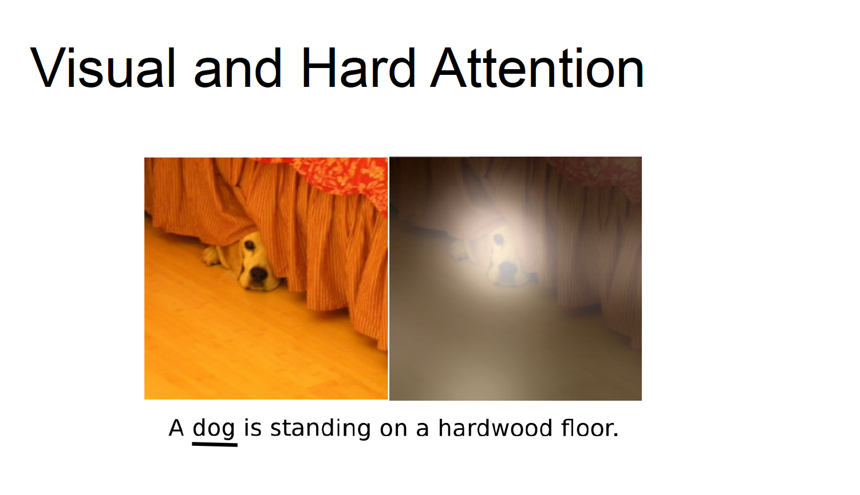

Slide 19
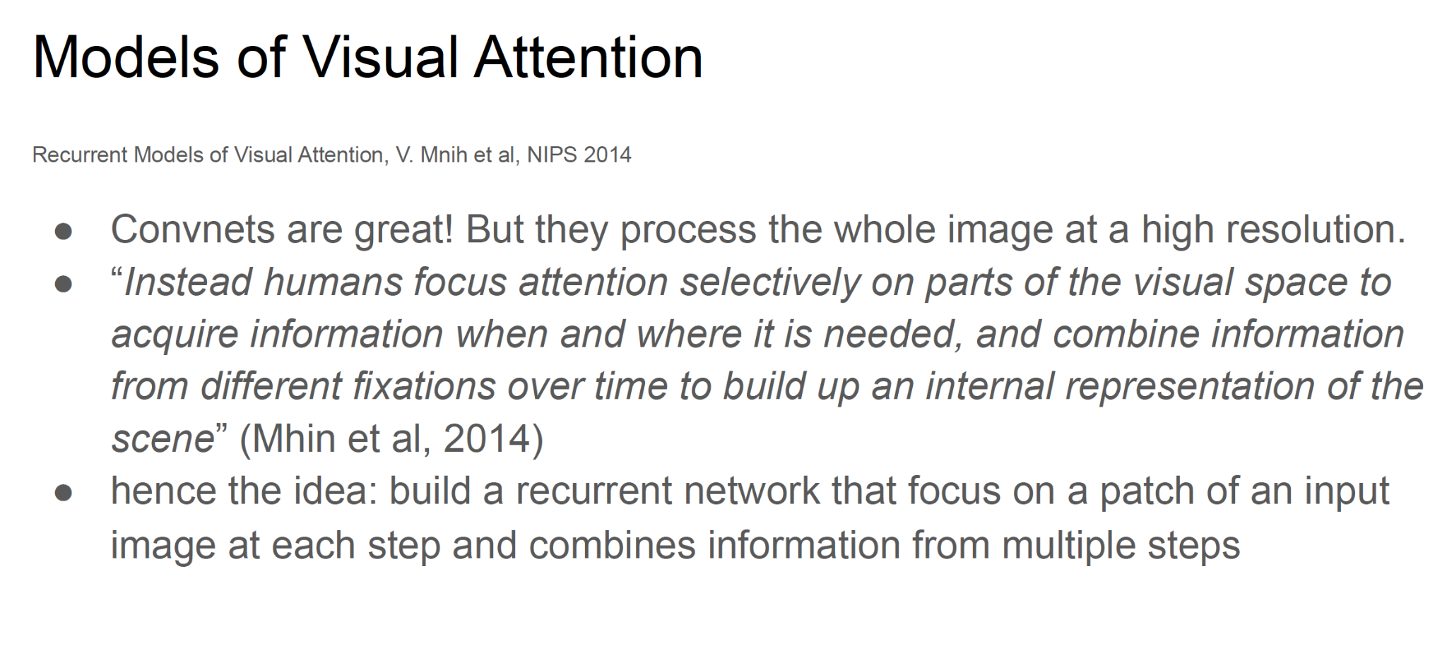
Attention

Slide 20
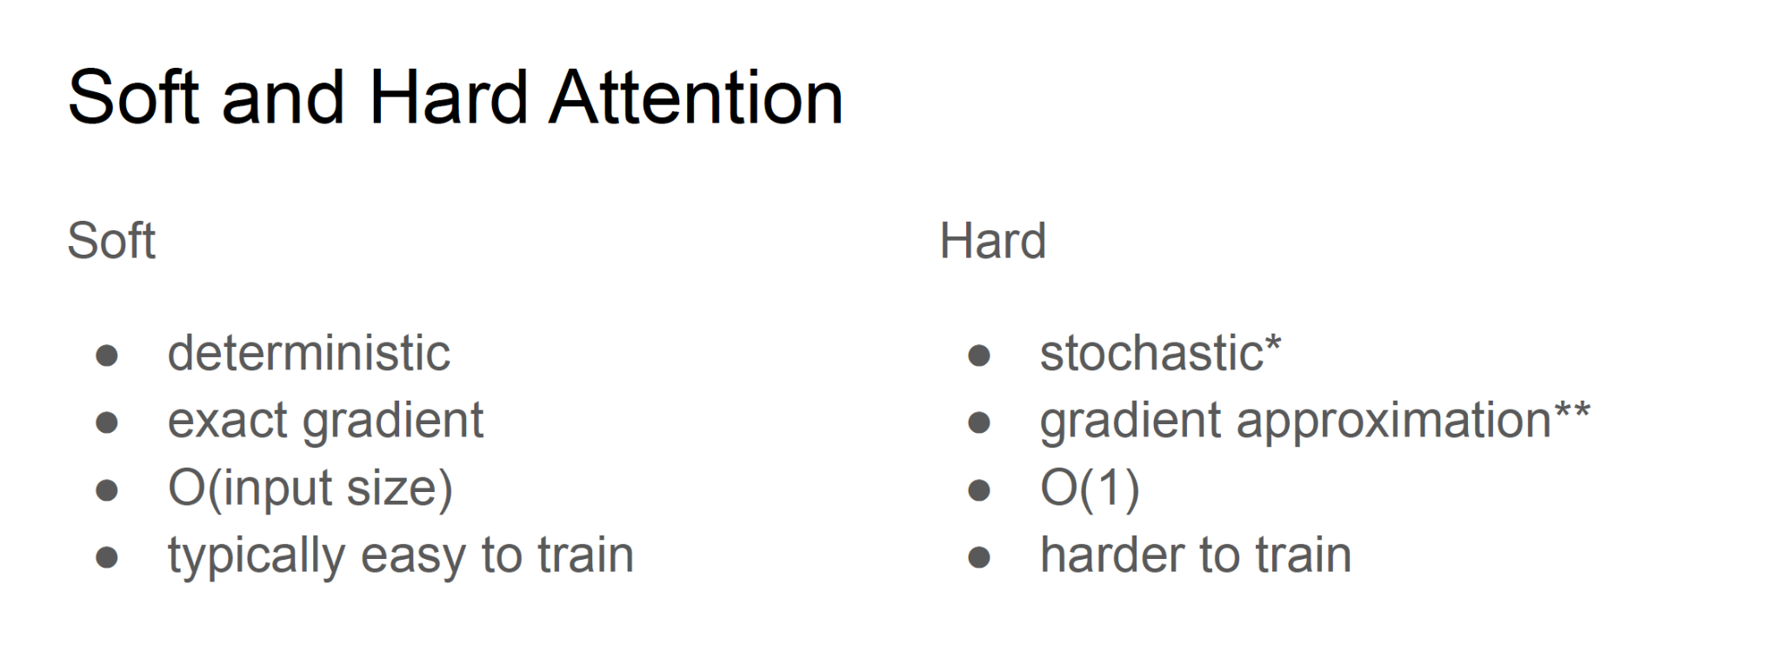
Attention

Slide 21
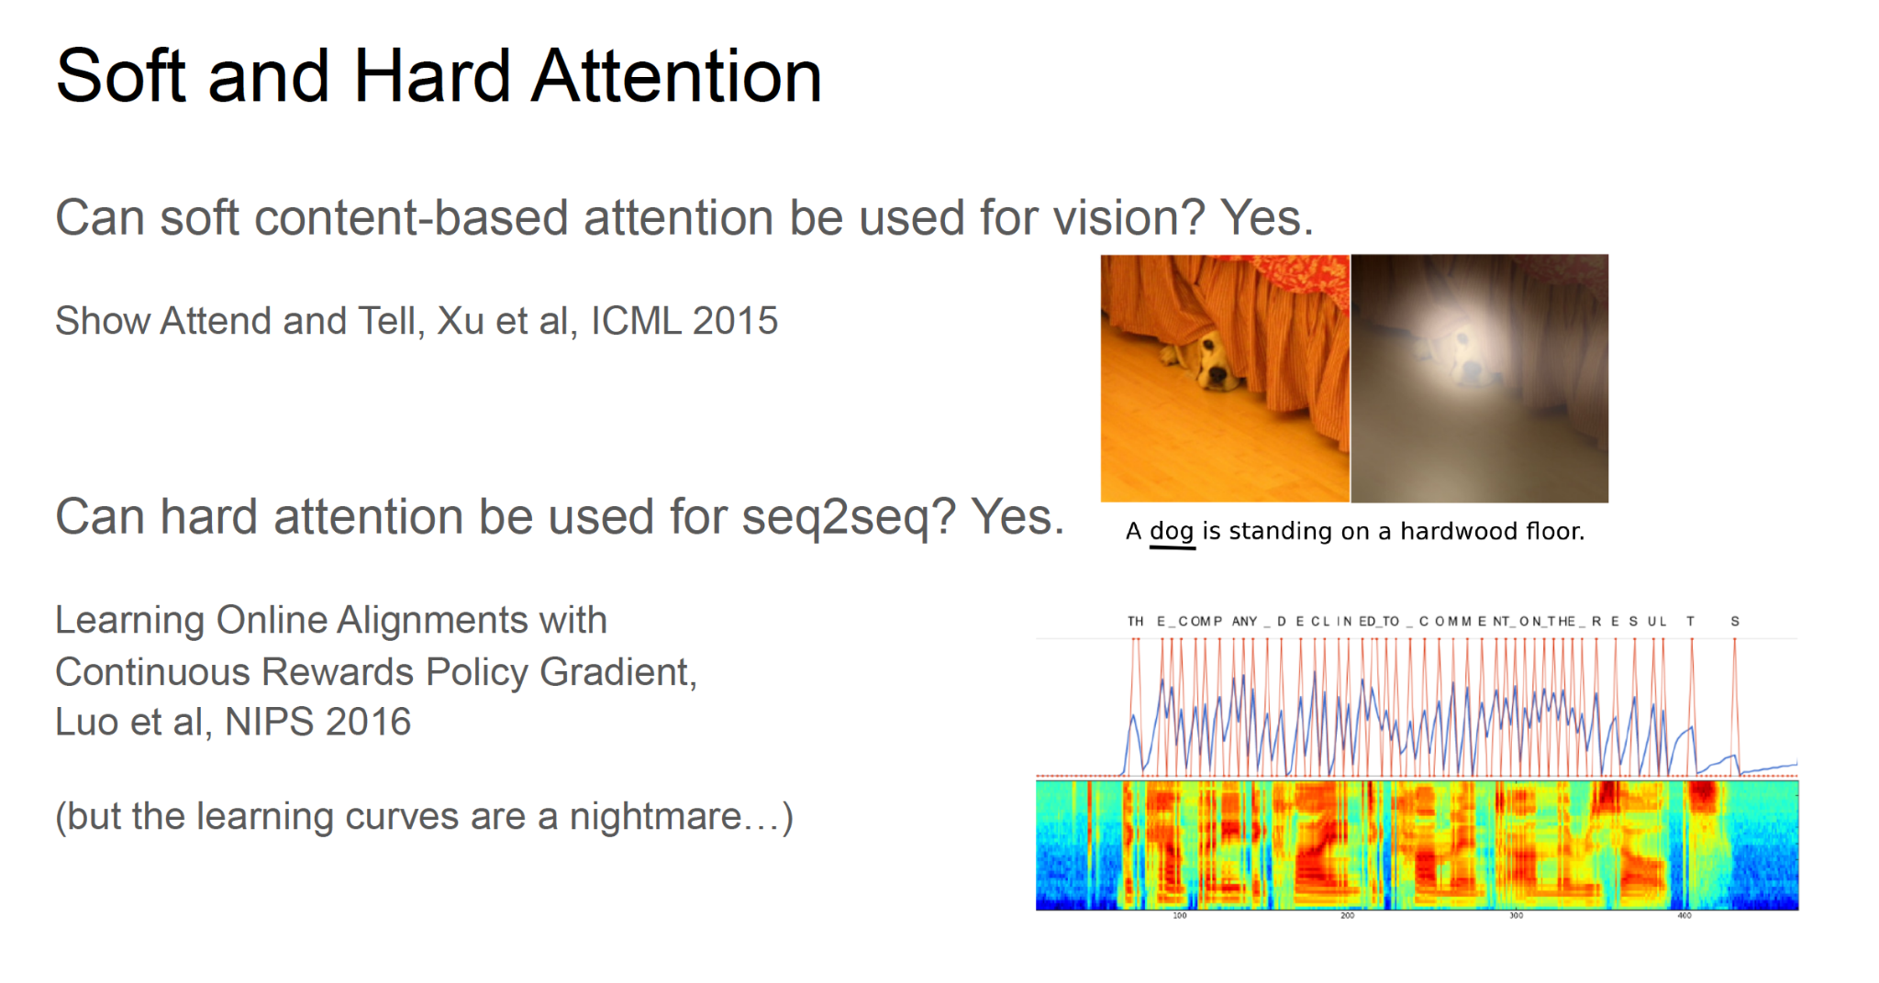
Attention

Slide 22
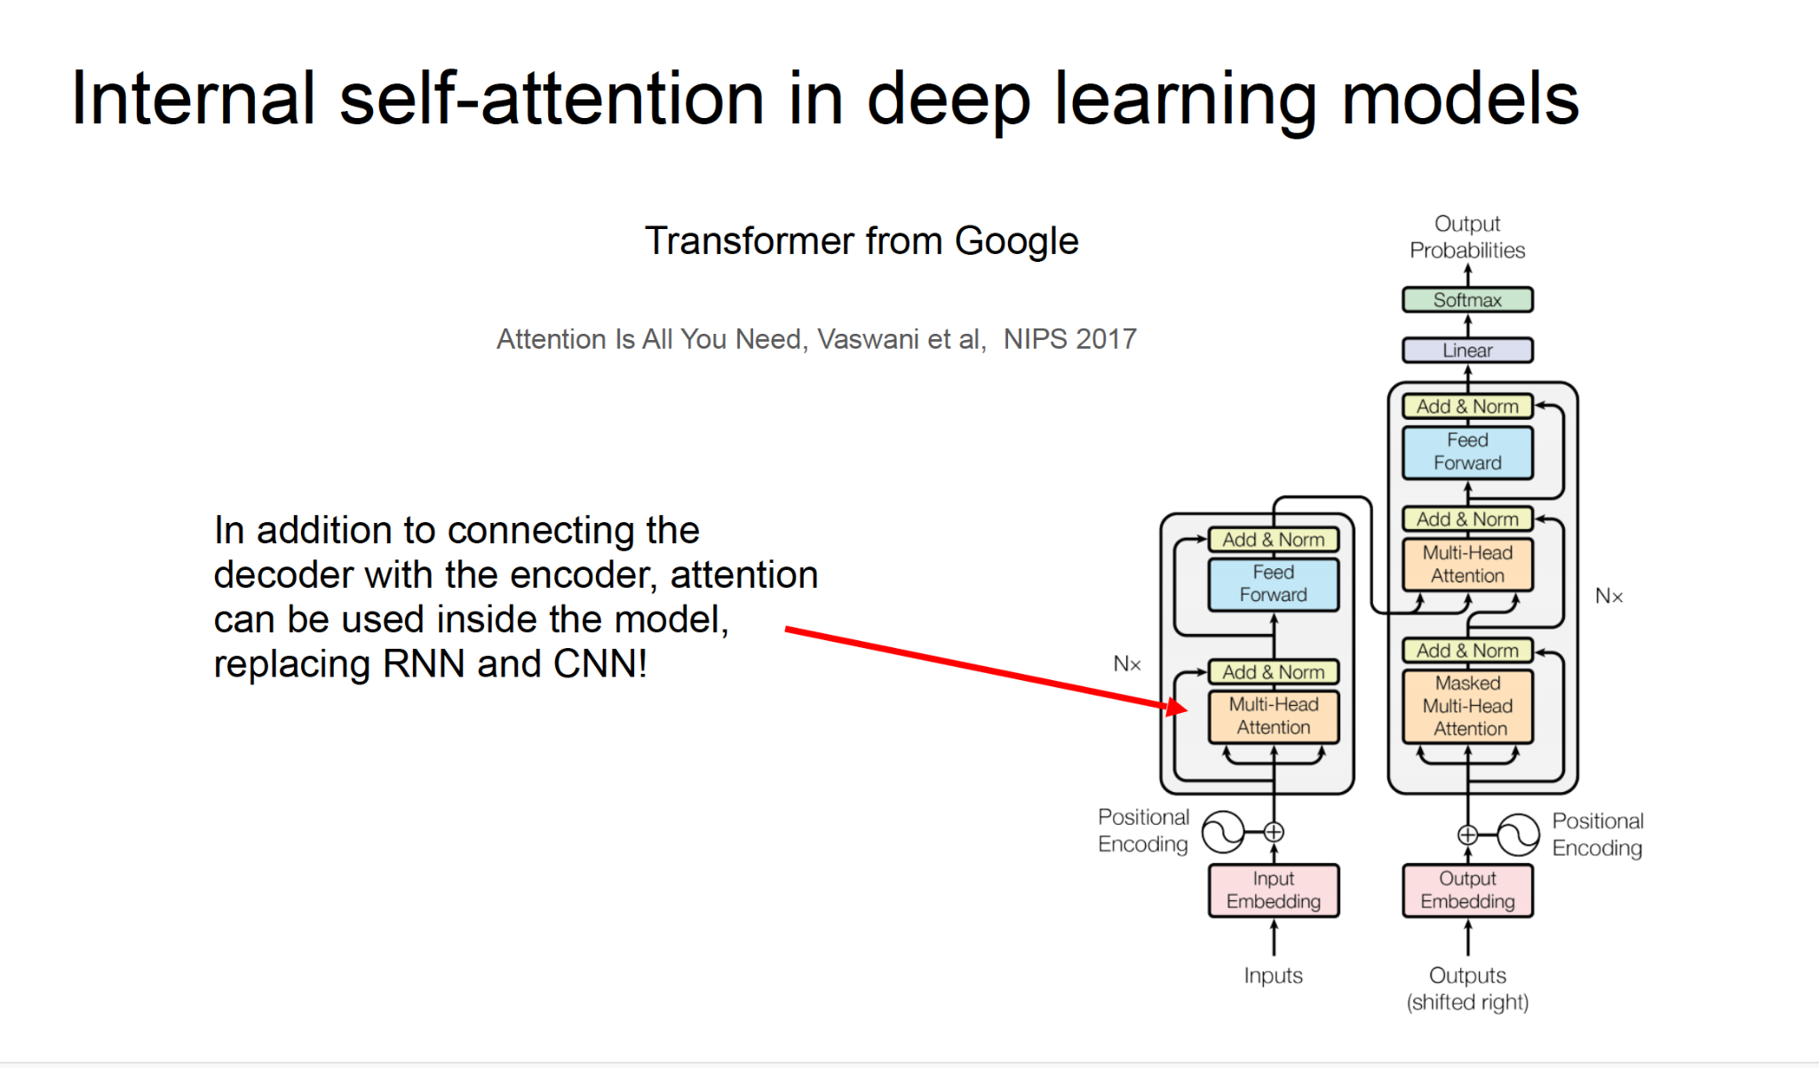
Attention

Slide 23
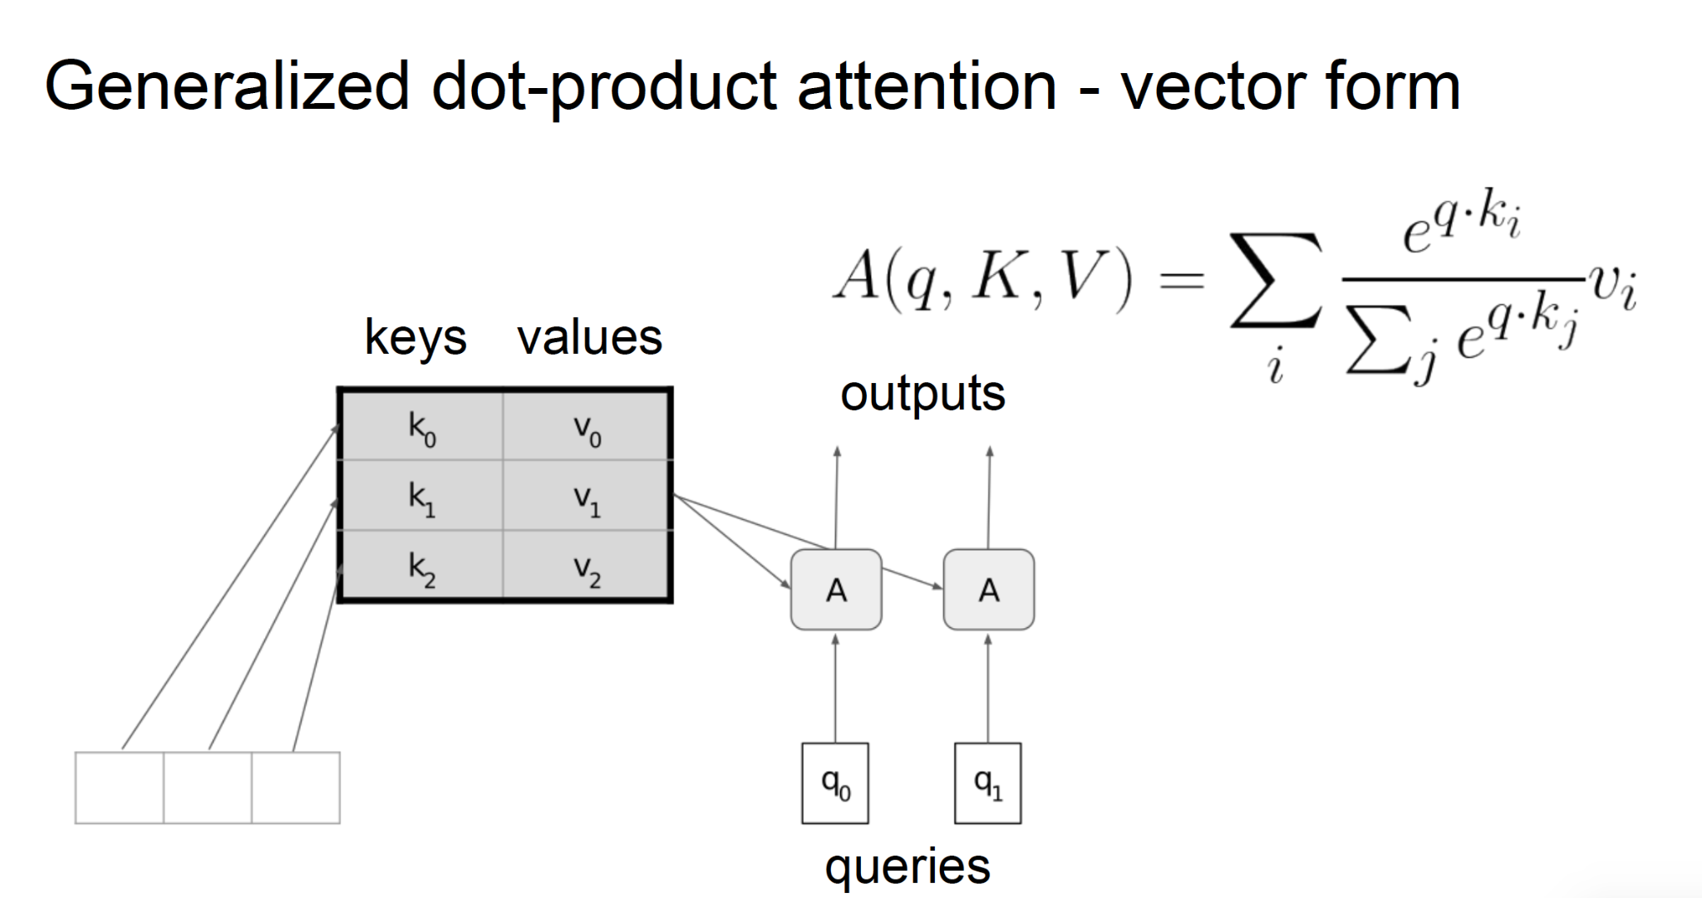
Attention

Slide 24
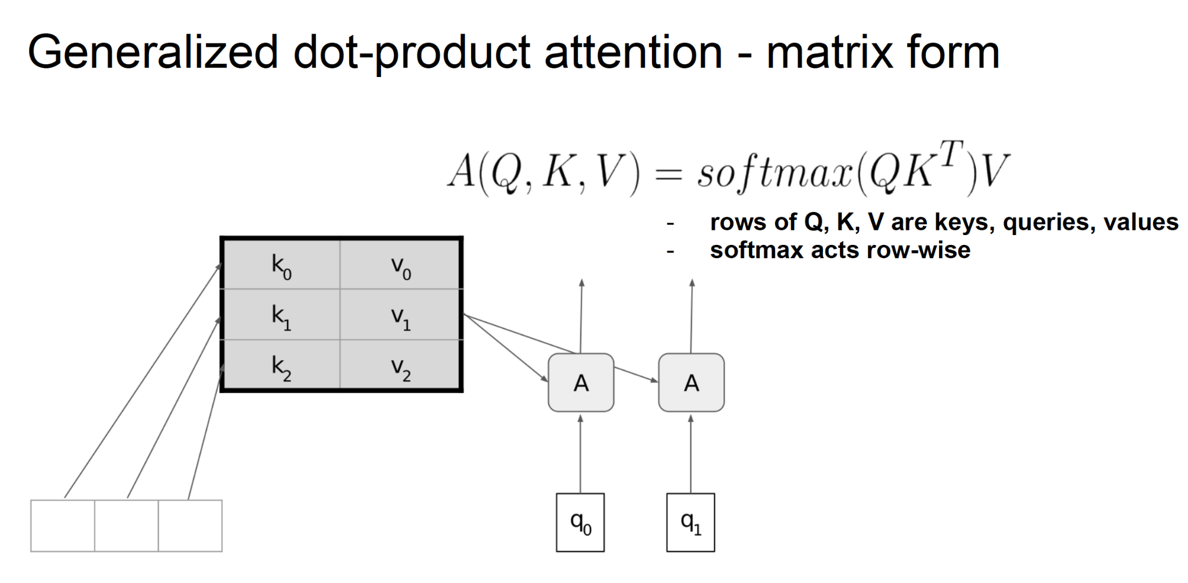
Attention

Slide 25
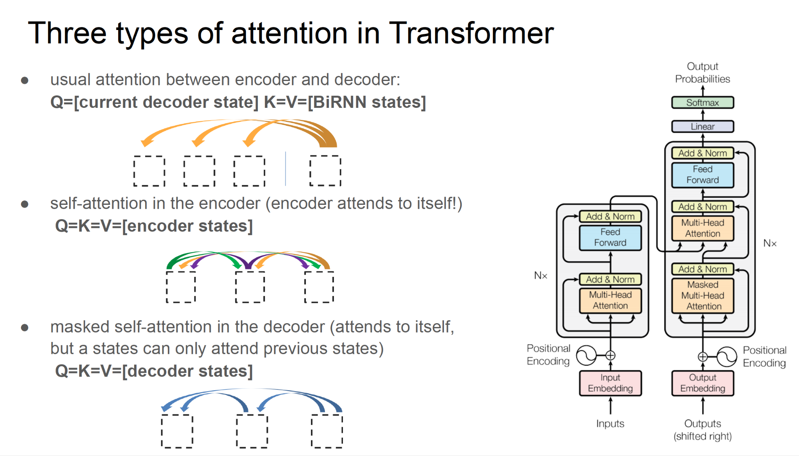

Slide 26
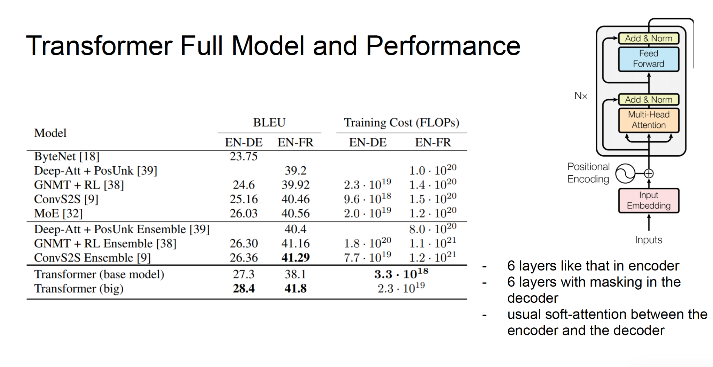

Slide 27
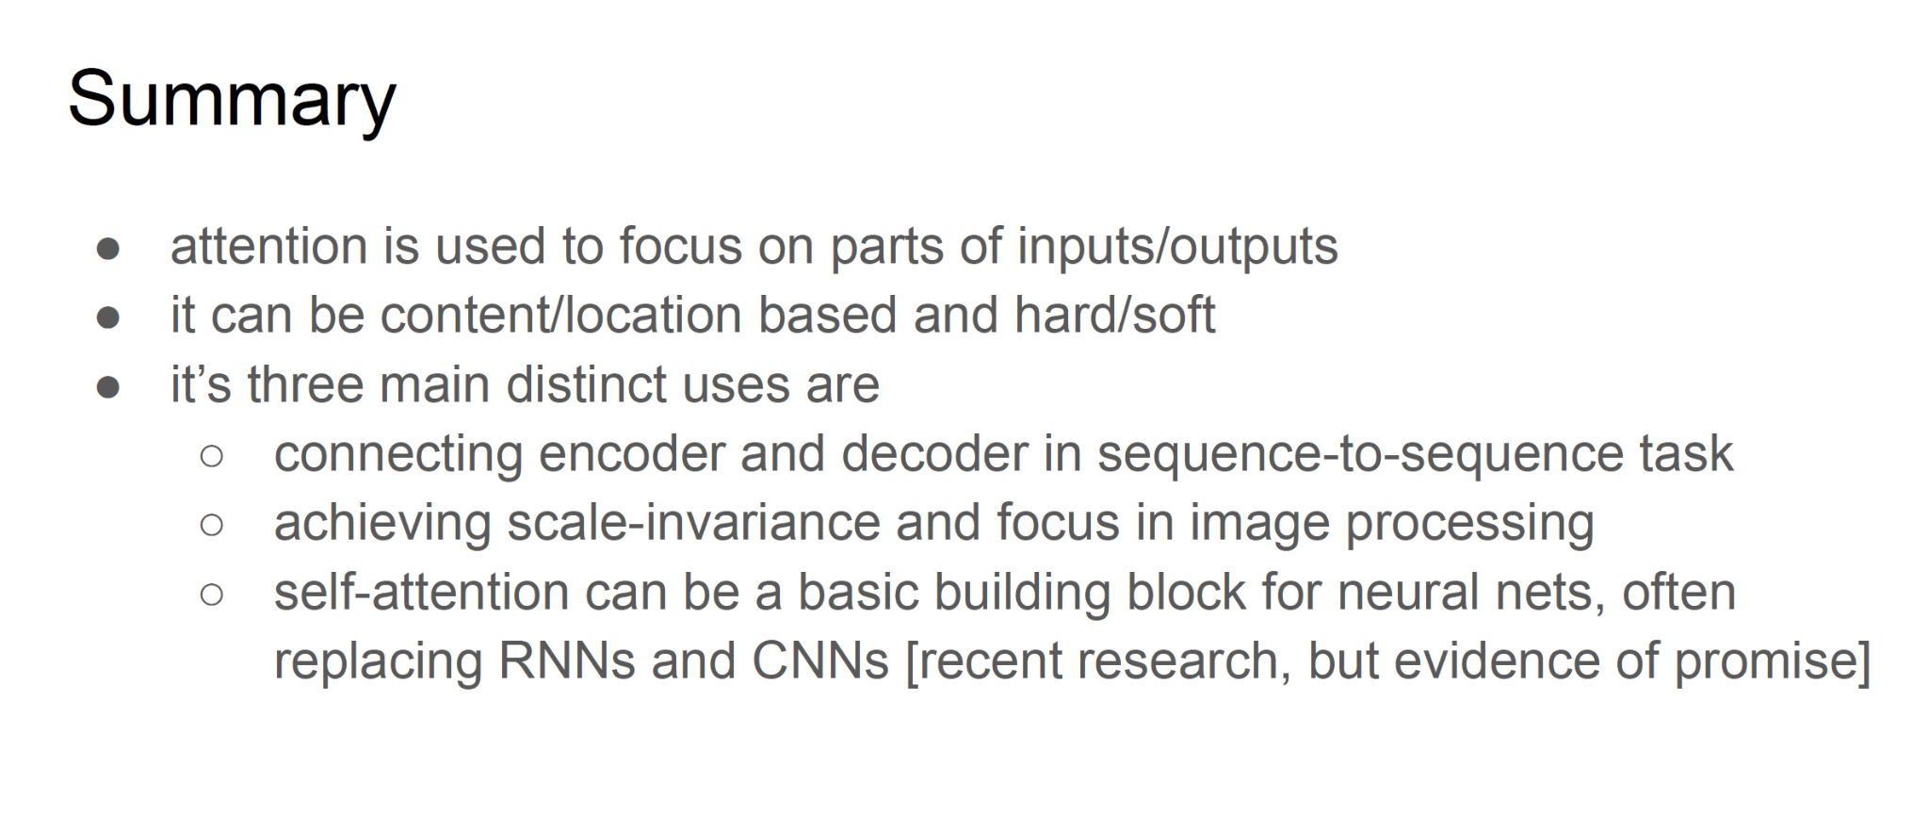

Slide 28
Questions?
Dr.Shruti Kshirsagar
Kshirsagarshruti1@gmail.com

Slide 29
References
1.https://blog.floydhub.com/attention-mechanism/
2.https://www.dropbox.com/s/e244jw50gv12498/Attention%20Models%20in%20Deep%20Learning.pdf?dl=0
3.

Slide 30
References
8.https://blog.paperspace.com/recurrent-neural-networks-part-1-2/
9.https://towardsdatascience.com/image-captioning-in-deep-learning-9cd23fb4d8d2
10.https://www.analyticsvidhya.com/blog/2021/12/step-by-step-guide-to-build-image-caption-generator-using-deep-learning/
11.https://keras.io/examples/vision/image_captioning/
12.https://arxiv.org/abs/2307.16686
13.https://visualqa.org/
14.https://arxiv.org/abs/1505.00468
15.https://medium.com/@niralidedaniya/visual-question-answering-a-deep-learning-classification-case-study-3d8df1eb48e3#:~:text=Visual%20Question%20Answering%20(VQA)%20allows,lead%20to%20lots%20of%20applications

